Slide 1

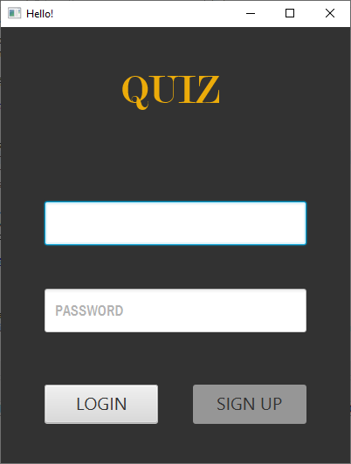
Online Quiz System : Using JavaFX
Group Members :-
Ronak Shah
Harsh Sangani
Shiva Kranti Maddhuri
QuizSavvy

Slide 2
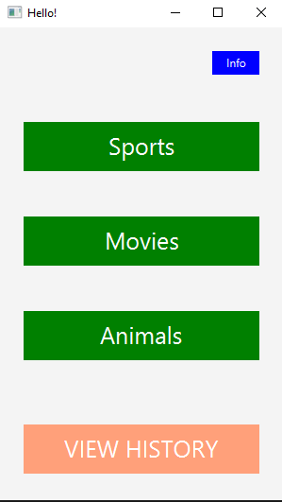
INTRODUCTION
OnlineQuizSystem is an intelligent prototype developed as a multiple choice question examination system which is built as a Web based application scalable to run on both intranet and internet. OnlineQuizSystem is intelligent enough and
equipped with a level of automation to guide the students to get proficiency/become subject matter experts by taking the tests.
The core underlying automation of the OnlineQuizSystem will generates questions and options on the fly basis and captures the answers from students into the database. It ensures that students will have the Mock Tests for practice, and can get the results displayed
in their panel.
The OnlineQuizSystem is designed for three major roles. Those are
An administrator who controls all the levels of roles and creates the tests.
A Student who is an end user for the tests.

Slide 3

OBJECTIVE OF THE PROJECT
Our idea is to create a comprehensive Online Quiz System that integrates various components to provide a seamless and engaging quiz-taking experience for users. This system will offer a solution to the problem of traditional, manual quiz administration, making it more efficient and accessible.
The idea to solve the problem of providing a convenient online quiz experience is to develop the "Online Quiz System." This system will involve the creation of a user-friendly platform using Java and JavaFX, with a strong emphasis on object-oriented design principles.

Slide 4
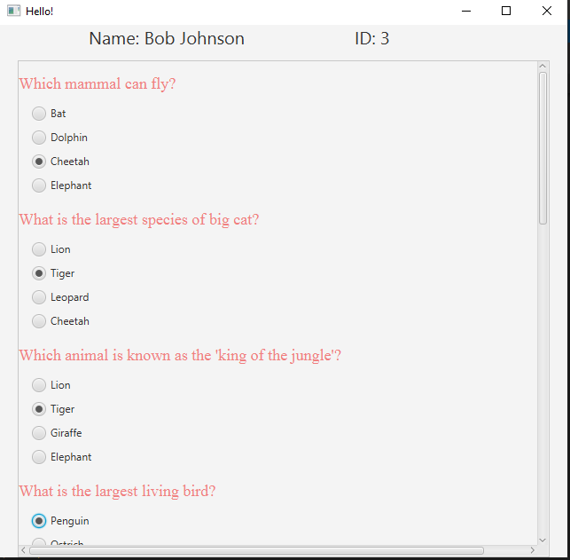
PROBLEM
STATEMENT
The problem we plan to solve with our project, the "Online Quiz System," is to address the need for a convenient and user-friendly platform that allows individuals to take quizzes on various
genres and receive immediate feedback on their performance. In traditional learning and assessment settings, conducting quizzes and providing prompt feedback can be a time-consuming and resource intensive task. Our solution aims to streamline and modernize this process by providing an online platform where users can easily access and engage in quizzes,
thereby enhancing the learning and assessment experience.

Slide 5

CHALLENGES AND SOLUTIONS IN Quiz System DEVELOPMENT
CHALLENGES
Quiz Rules Implementation: Ensuring accurate quiz logic for complex rules.
GUI Design: Designing an intuitive and visually appealing user interface.
User Experience: Catering to both beginners and experienced users.
Comprehensive Testing: Ensuring bug-free and quality quiz play.
SOLUTIONS
Robust Logic: Develop detailed algorithms for all quiz rules.
JavaFX Utilization: Employ JavaFX for responsive and clear GUI.
Adjustable Various Quiz Genres: Include genres for various quiz types.
Rigorous Testing: Implement unit, integration, and user testing.

Slide 6
APPROACH
Object Oriented Design
JavaFX for GUI
Event Driven Programming
Class Definition
Quiz Logic and Rules
Resource Management
Inheritance & Polymorphism
Array Lists

Slide 7
TECHNOLOGIES USED
Java: The primary programming language used in the project.
JavaFX: Used to create the Graphical User Interface(GUI) of the project.
FXML: Used to define the layout of the Quiz system through Scene Builder.
Eclipse: Used as the environment for the project.
Trello: Task Management Tool.
Git: Used to coordinate the work within the team members.

Slide 8
IMPLEMENTATION
User Registration and Authentication: Users will be able to register and log in to their accounts, ensuring a personalized and secure experience.
Quiz Categorization: Quizzes will be categorized into different subjects or topics, allowing users to easily browse and select quizzes based on their interests.
Question and Answer Handling: We will design classes to represent questions and answers. Each question will belong to a specific quiz and have multiple choice or true/false answers.
Quiz Management: Classes will be created to manage quizzes, including their questions, answers, and scoring mechanisms. This ensures that quizzes are well-organized and structured.
Scoring System: We will implement a scoring system that calculates the user's score based on their quiz performance. This involves creating classes to calculate scores and track user scores for different quizzes.
Quiz User History: Users will have the ability to view their past quiz attempts and scores. Classes will be designed to manage and display this information, promoting continuous learning and self assessment.
User Interface: JavaFX will be used to create an intuitive and user-friendly interface for users to browse quizzes, select options, and view results. This ensures a visually appealing and easy-to-navigate platform.
Admin Features: For additional flexibility, we may implement admin features to manage quizzes, add new questions, and review user data. This would facilitate the system's scalability and management.

Slide 9
FUTURE SCOPE
AI Integration: Introduce AI Opponent for single player mode.
Online Multiplayer Functionality: Allows players to compete against each other over the internet.
Enhanced User Interface: Improved GUI with better graphics and animations.
Educational Tools: Add tutorials for new players to learn how to go through the Quiz System.
Social Features: Add option to chat with players when playing against them.

Slide 10
CONTRIBUTIONS
Harsh Sangani: Creation of project, setting up JavaFX application, implementation of the Quiz Login Page and representation of the User History tab along with the Quiz Scoring System.
Shiva Kranti Maddhuri: Develop the quiz logic to handle the quiz genres & integrating it with the database, MySql.
Ronak Shah: Developing the entire Admin route for the Quiz System & integrating it with the database, MySql.

Slide 11
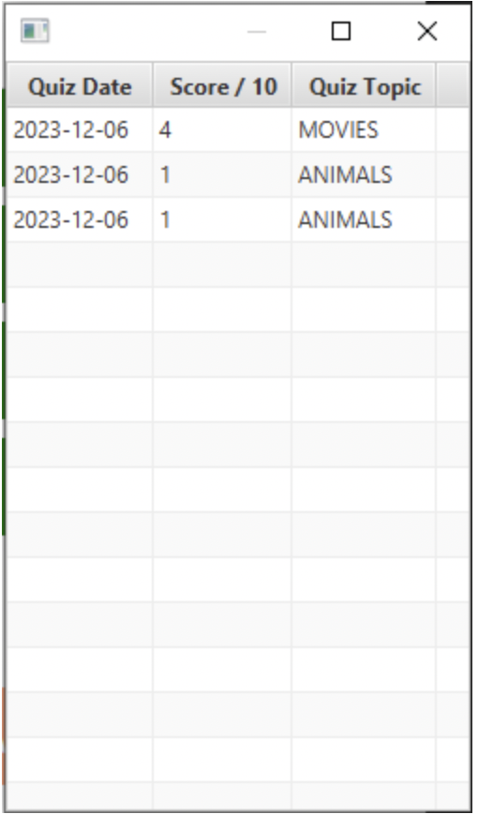
THANK YOU!
LET'S PLAY
QuizSavvy!

